Slide 1
Lecture 10 & 11
19ECE204

Slide 2
Incompletely Specified Functions
In digital systems it often happens that certain input conditions can never occur.
For example, suppose that x₁ and x₂ control two interlocked switches such that both switches cannot be closed at the same time.
Thus the only three possible states of the switches are that both switches are open or that one switch is open and the other switch is closed.
So the input valuations (x₁, x₂) = 00, 01, and 10 are possible, but 11 is not.
Then we say that (x₁, x₂) = 11 is a don’t-care condition
means the circuit with x₁ and x₂ as inputs can be designed by ignoring this condition.
A function that has don’t-care condition(s) is said to be incompletely specified.
The advantage is that, the designer may choose any value of 0 or 1 for this don’t care valuations depending on convenience to obtain the least cost implementation.

Slide 3


Contd.
0 | 1 | d | 0
0 | 1 | d | 0
0 | 0 | d | 0
1 | 1 | d | 1
Consider the K-map shown
Here, it is assumed that similar to the interlocked
switches, the x₁ and x₂ inputs will never be equal
to 1 at the same time.
Hence the minterms m₁₂, m₁₃, m₁₄, and m₁₅ can all be
considered as don’t-cares (marked as ‘d’)
The function can be specified in SOP form as,
where D is the set of don’t-cares.
To obtain the least cost expression, the don’t-cares D₁₂, D₁₃, and D₁₄ (corresponding to minterms m₁₂, m₁₃, and m₁₄) can be assumed as 1 while D₁₅ as 0.

Slide 4
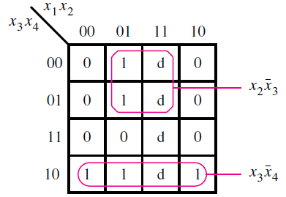

SOP Implementation
There are only two prime implicants and
both are essential
The resulting least cost expression is,
Instead, if we had excluded the don’t-cares from the synthesis of the function, by assuming that they always have a value of 0, the resulting SOP expression would be

Slide 5
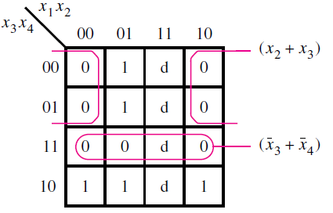
POS implementation
For the previous case of values for don’t cares
the corresponding POS expression would be
Now, if we had considered all ‘d’ as zero, then the POS
implementation would be
Thus, the don’t care values should be considered in such a manner that we can obtain the cost- efficient expression with minimum grouping of terms.

Slide 6
Example 2
Determine the minimum-cost SOP and POS expressions for the function
To find the minimum-cost SOP expression, it is necessary to find the prime implicants that cover all 1s in the map.
0 | 1 | 1 | 1
0 | d | 0 | d
d | d | 1 | 1
0 | 1 | 0 | 1

Slide 7
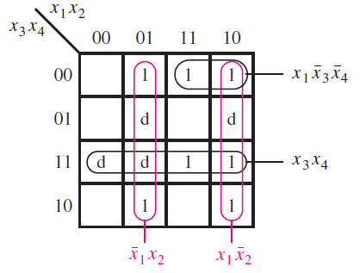
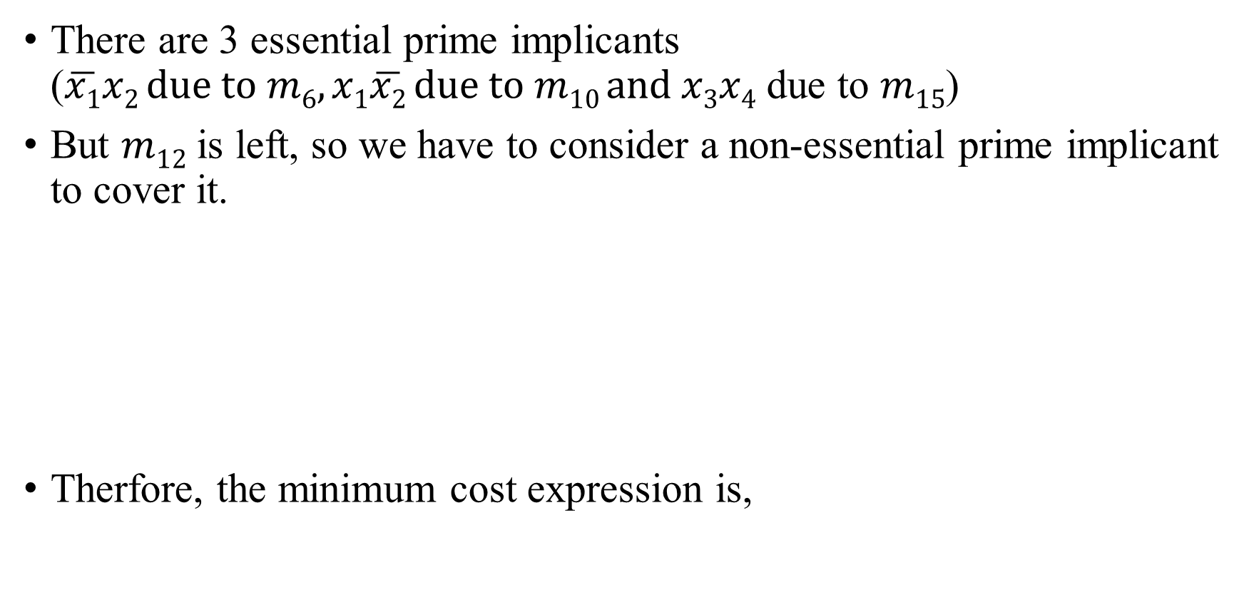
SOP Implementation
There are 3 essential prime implicants ($\overline{x1}x2 due to m6,x1\overline{x2} due to m10 and x3x4$ due to $m15$)
But $m12$ is left, so we have to consider a non-essential prime implicant to cover it.
Therfore, the minimum cost expression is,

Slide 8
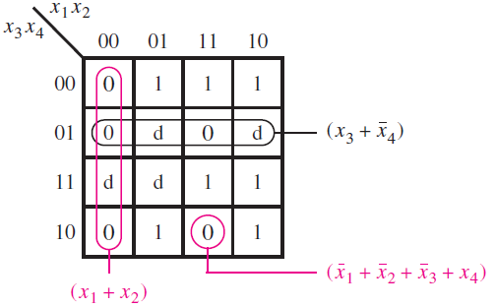
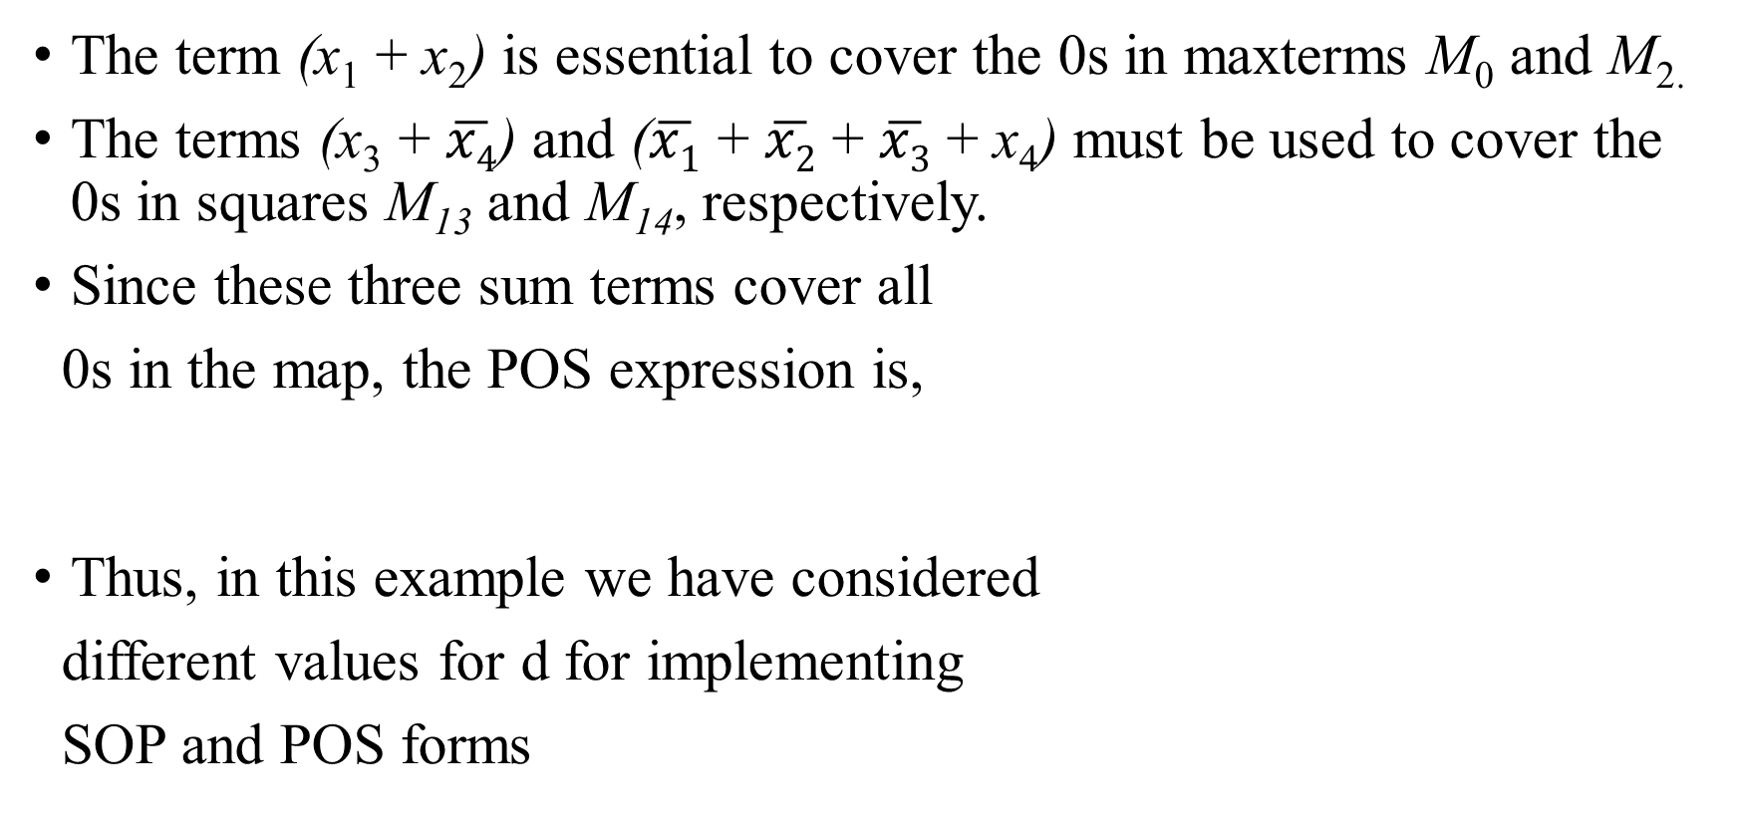
POS implementation
The term (x₁ + x₂) is essential to cover the 0s in maxterms M₀ and M_{2.}
The terms (x₃ + $\overline{x4}$) and ($\overline{x1}$ + $\overline{x2}$ + $\overline{x3}$ + x₄) must be used to cover the 0s in squares M₁₃ and M₁₄, respectively.
Since these three sum terms cover all
0s in the map, the POS expression is,
Thus, in this example we have considered
different values for d for implementing
SOP and POS forms

Slide 9
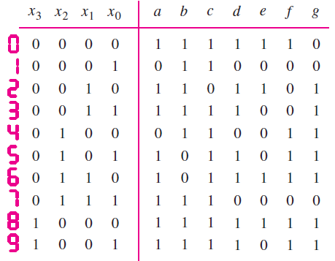
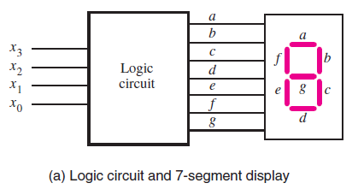
Example 3
Design a circuit which takes a four-bit binary number X = x₃x₂x₁x₀ that represents the decimal values 0, 1, . . . , 9 and display the same.
Sol : Using four bits to represent decimal digits in this way is often referred to as the binary coded decimal (BCD) representation.
The figure shows the inputs (x₃ , x₂ , x₁ , x₀) and the 7 segment outputs (a, b, . . . , g) that control the display.

Slide 10
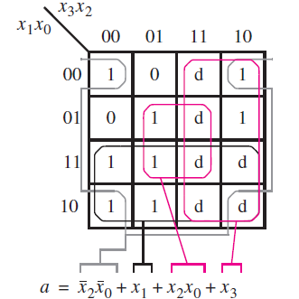
Contd.
From, the truth table, one can see that, since X is restricted to decimal digits, then the values of X from 1010 to 1111 are not used.
These entries are omitted from the truth table and can be treated as don’t cares in the design of the circuit.
The logic expressions for the outputs a to g, can be derived using K- maps. But, here we discuss for a and e only
Figure gives Karnaugh maps
for the function a.
Assuming all d as 1, we get the minimum cost
implementation for a as,

Slide 11
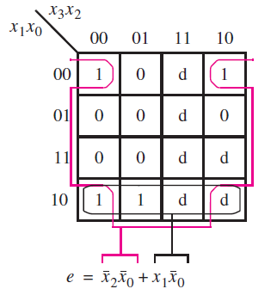
Contd.
K-map for e is shown.
For optimal simplification, we can set don’t cares corresponding to m₁₁ and m₁₄ only as 1 and rest as 0.
Thus, the minimum cost expression is,
Similarly, find out the least cost expressions
for the other segments b,c,d,f and g as an
exercise. Also find the minimum cost POS
implementations of all segments.

